Slide 1
Multimedia Fundamentals
Keertikumar A
Bharath P
Ashwini H P

Slide 2
Contents
Introduction to Multimedia Framework.
Android Multimedia Framework.
Gstreamer Framework.
Video Codec.

Slide 3
Introduction to Multimedia Framework
Multimedia Framework is software framework that handles media on computer and through network.
A good Multimedia Framework offers a modular architecture to easily support for new audio, video, container formats and for Transmission protocols also.
Examples :
1. Gstreamer Framework
2. Direct Show
3. Quick Time

Slide 4
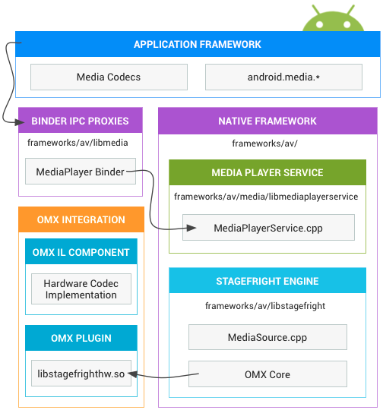
Android Multimedia Framework

Slide 5
At the native level, Android provides a multimedia framework that utilizes the Stage-fright engine for audio and video recording and playback.
Stage-fright comes with a default list of supported software codecs and you can implement your own hardware codec by using the OpenMax integration layer standard.
The OpenMax IL provides a standardized way for Stage-fright to recognize and use custom hardware based multimedia codecs called camponents.

Slide 6
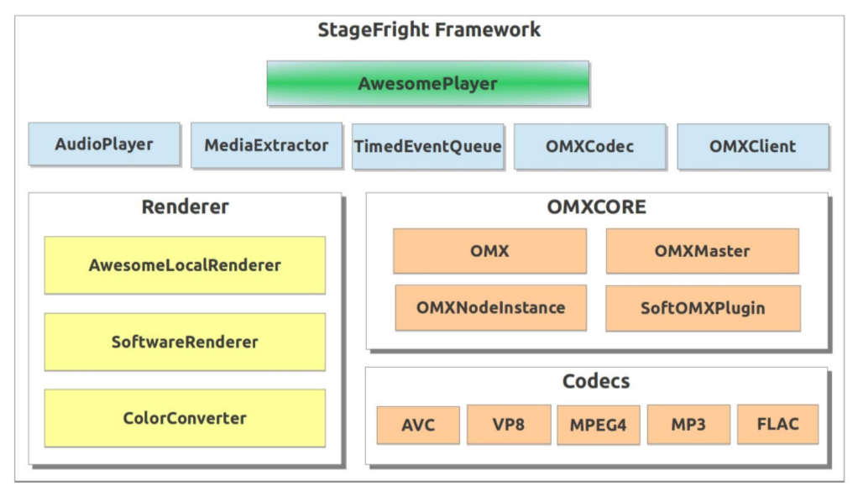
Big Picture of Stage-fright Engine

Slide 7
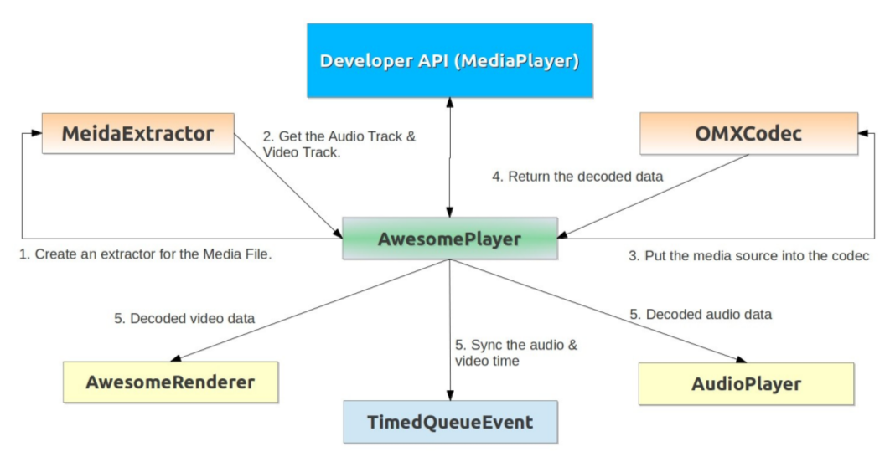
Stage-fright Work flow

Slide 8
Gstreamer
Gstreamer is a pipeline based multimedia framework.
Why using Gstreamer?

Slide 9
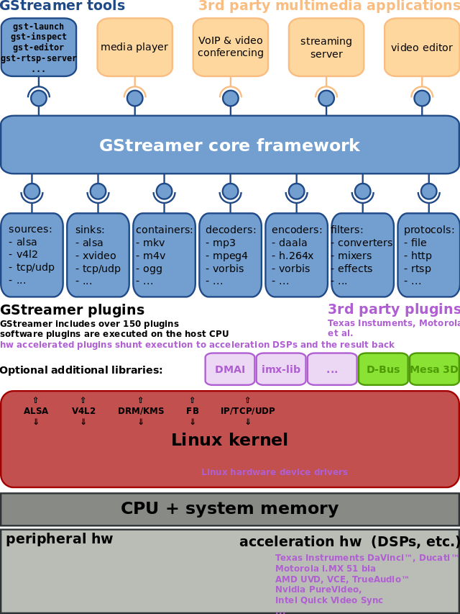
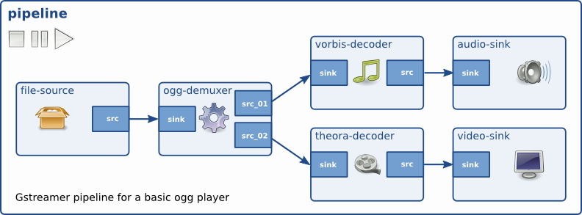
Overview
Gstreamer Framework uses plugin architecture.
Plugins can be linked and arranged in a pipeline.

Slide 10
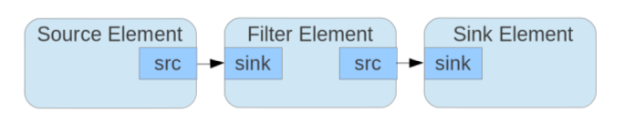
Element:
Gstreamer Building Blocks
The states of element are.,
  null: no resource is allocated
  ready: resources are allocated, but the streams are not opened
  pause: streams are opened but no processed
  play: streams are being processed
Each element can change state during the execution of application.

Slide 11
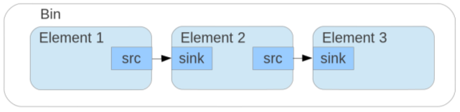
Continued.,
Bin:
Bin is an element which contains other elements.
Since it is an element it can have the same states as mentioned for element.
Pad:
The pads are element's interface. Streams flow from an element's source pad to another element's sink pad.

Slide 12
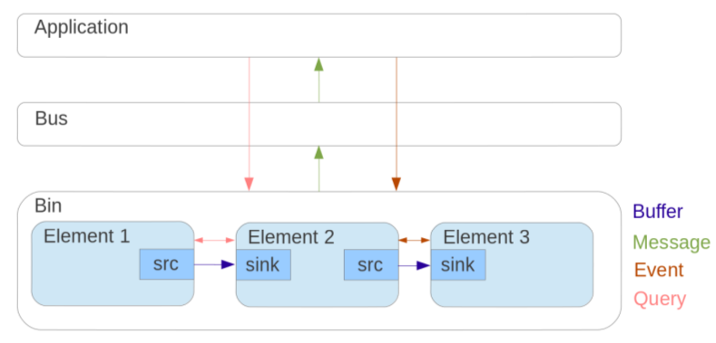
Continued.,
Buffers: They can pass streaming data between elements in the bin.
Events: Objects used to notify elements which are waiting for a particular event to occur.
Message: Objects posted on pipeline bus to notify the application of any particular information(bugs,state changes,end of streams).
Query: Objects sent from application or between elements to ask a particular information(duration, positions, etc.,).

Slide 13
Video Codec
RGB and YUV formats.
Video codec:
  Video encoding
  Video decoding

Slide 14
RGB and YUV format
RGB :
  RGB color space or RGB color system, constructs all the colors from the combination of the Red, Green and Blue colors.
  The red, green and blue use 8 bits each, which have integer values from 0 to 255. This makes 256*256*256=16777216 possible colors.
YUV :
  YUV is a way of breaking the brightness and colors in the image down into numbers.
  Y → Luminance and UV → Chrominance

Slide 15
RGB and YUV format
Most cameras take the light coming into the lens, and convert that into 3 sets of numbers, one for Red, one for Green, and one for Blue(RGB).
If we need to lower the brightness uniformly on an image, we need to do it to all 3 colors. There’s also a LOT of redundancy in the data.
To solve this there we need to convert from RGB to YUV.
Which breaks the signal down into a Y, or luminance component, and 2 components that store color info without brightness info – a Blue component and a Red component that don’t contain any brightness.

Slide 16
Video codec
The process of compression involves applying an algorithm to the source video to create a compressed file that is ready for transmission or storage(encoder).
To play the compressed file, an inverse algorithm is applied to produce a video that shows virtually the same content as the original source video(decoder).
A pair of algorithms that works together is called a video codec (encoder/decoder).
Video compression standards are, Motion JPEG, MPEG-4 Part 2 (or simply referred to as MPEG-4) and H.264. H.264 is the latest and most efficient video compression standard.

Slide 17
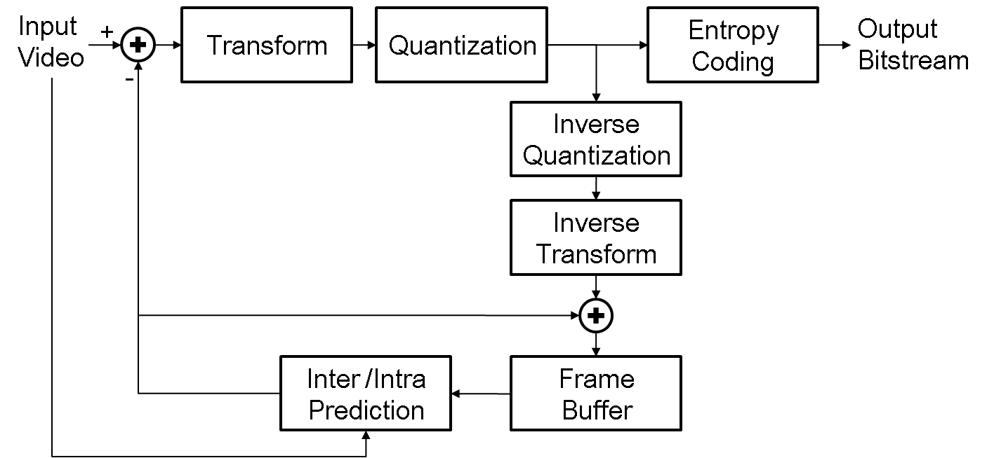
Video encoding

Slide 18
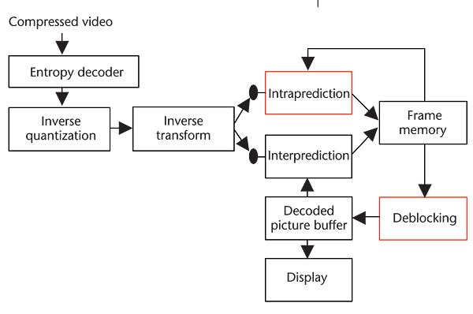
Video decoding

